Slide 1
Effect of Inhibitory Gamma Rhythm Conductance on Nonlinearity
2/6/2024

Slide 2
GOAL
We are interested in determining the effect of increasing varying firing rate of GABA (background) and NMDA/AMPA (excitatory) synapses has on our model.

Slide 3
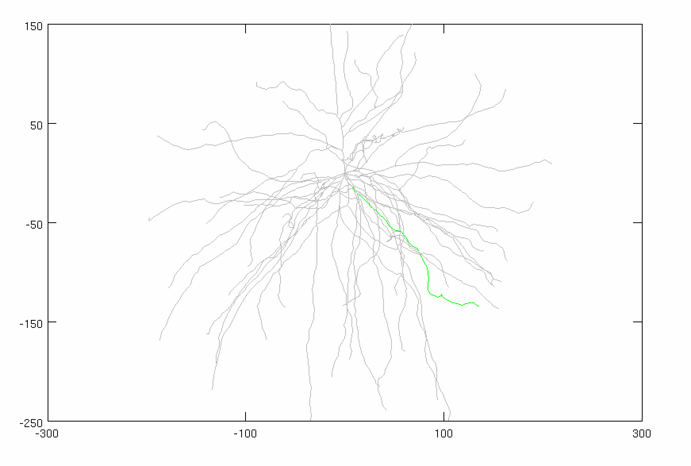
Model Parameters
Inhibitory Gamma
N_syn = 30 (ON SOMA)
Firing rate: VARIABLE
Distribution: VARIABLE
Conductance: 0.005 µS
Adjusted Current
Amplitude: VARIABLE
Noise: 0 nA
Stimulus
Total synapses: 40 synapses
AMPA: 0.0015 µS
NMDA: 0.0039 µS
Firing rate: 50 Hz
Start Time: 5 ms
Noise: 0 ms
Location: 50% of DEND
(FOCAL, SYNCHED)
AVG: 25 trials
CONSTANT

Slide 4
CASE #1:
Frequency: 10 Hz
GABA Firing Distribution: 15 ms
Current Amplitude: 1.09 nA

Slide 5
CASE #2:
Frequency: 25 Hz
GABA Firing Distribution: 6 ms
Current Amplitude: 1.26 nA

Slide 6
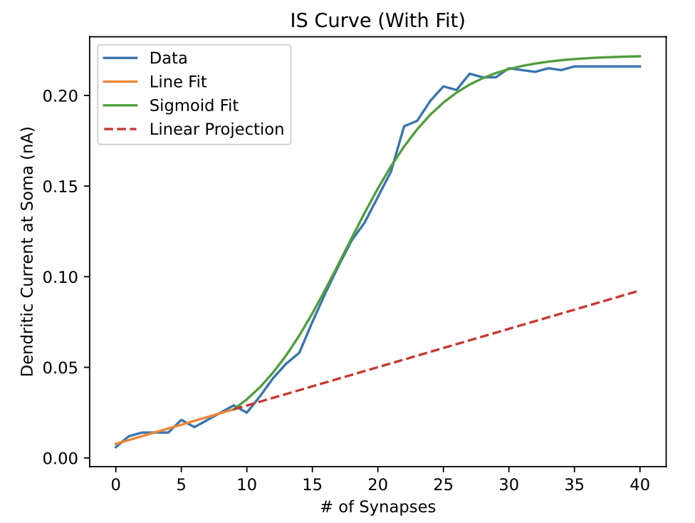
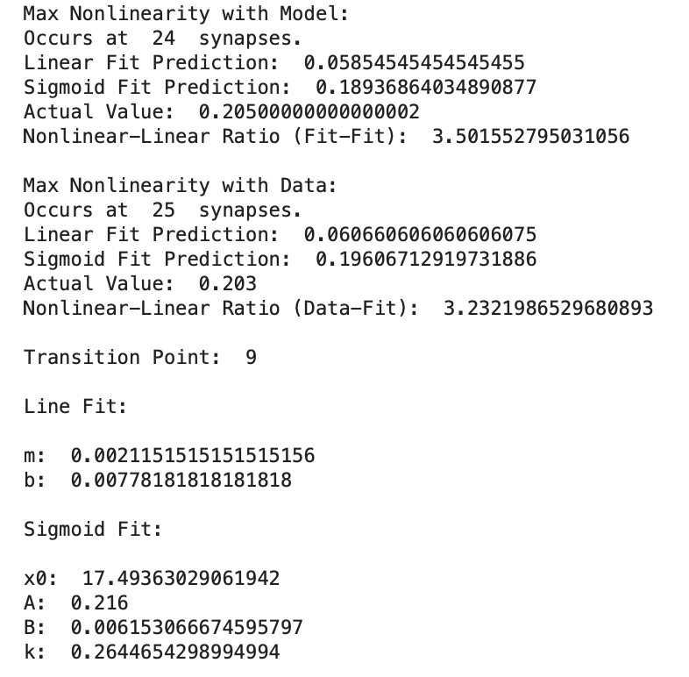
CASE #2:
Frequency: 25 Hz
GABA Firing Distribution: 6 ms
Current Amplitude: 1.26 nA

Slide 7
CASE #3:
Frequency: 50 Hz
GABA Firing Distribution: 3 ms
Current Amplitude: 1.875 nA

Slide 8
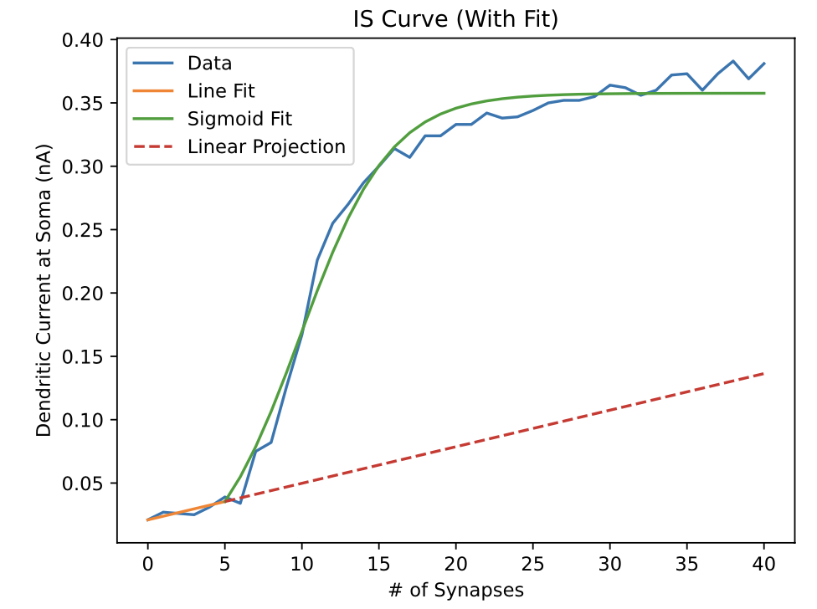
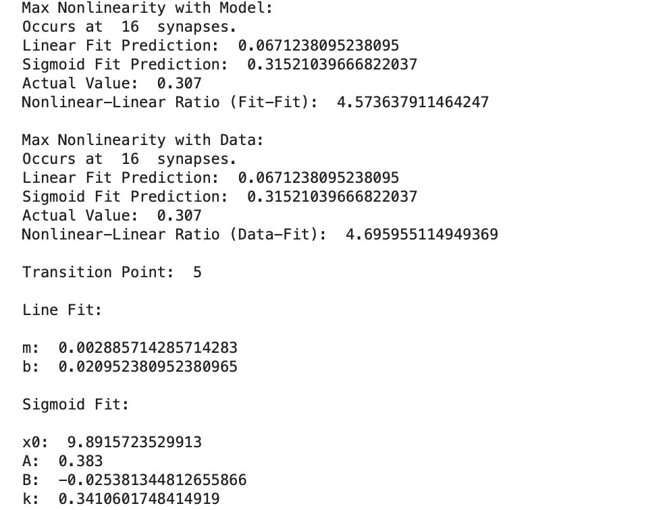
CASE #3:
Frequency: 50 Hz
GABA Firing Distribution: 3 ms
Current Amplitude: 1.875 nA

Slide 9
CASE #4:
Frequency: 75 Hz
GABA Firing Distribution: 2 ms
Current Amplitude: 2.56 nA

Slide 10
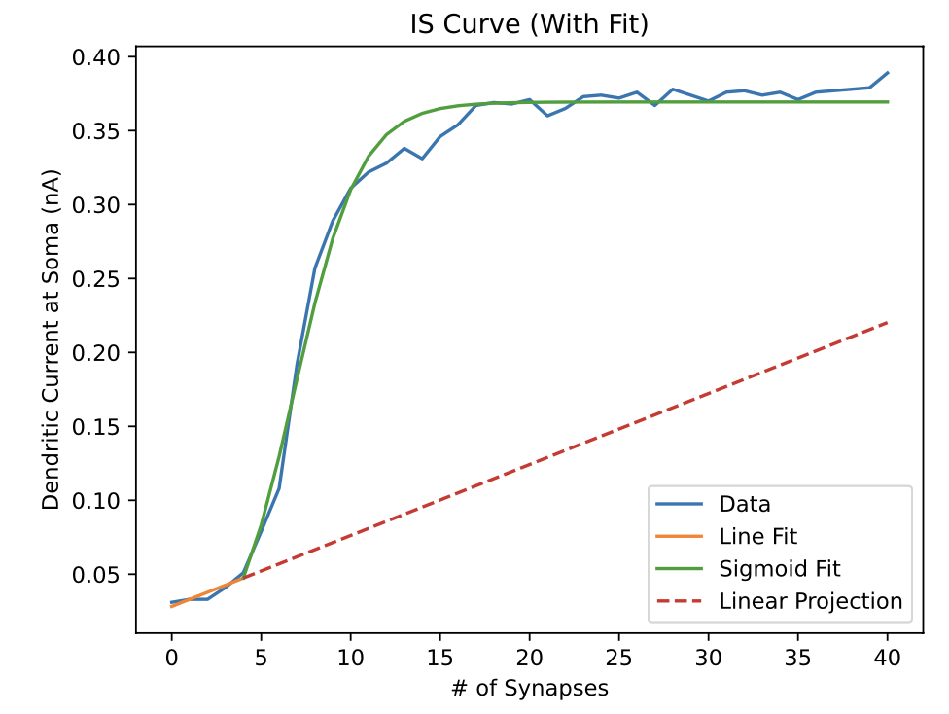
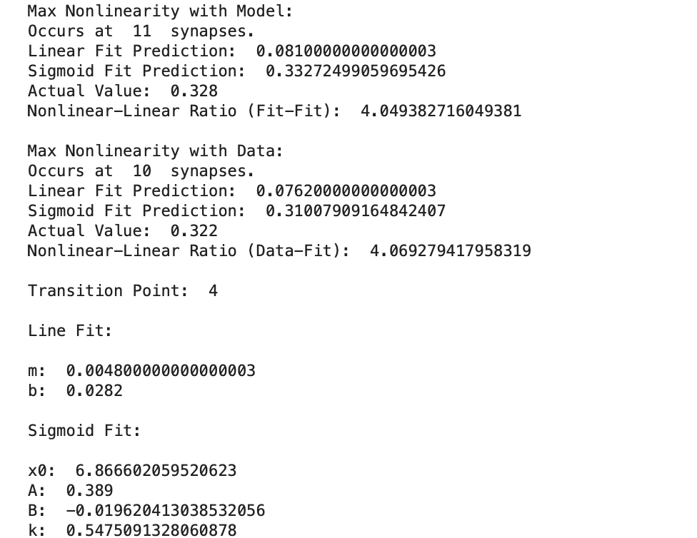
CASE #4:
Frequency: 75 Hz
GABA Firing Distribution: 2 ms
Current Amplitude: 2.56 nA

Slide 11
CASE #5:
Frequency: 100 Hz
GABA Firing Distribution: 1.5 ms
Current Amplitude: 3.33 nA

Slide 12
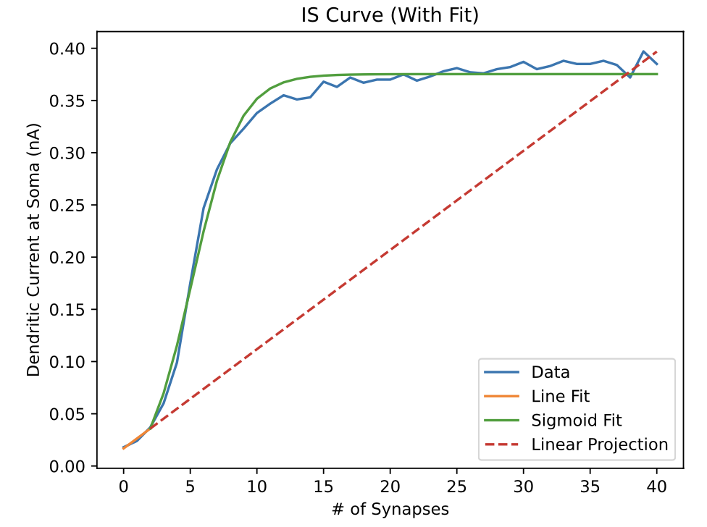
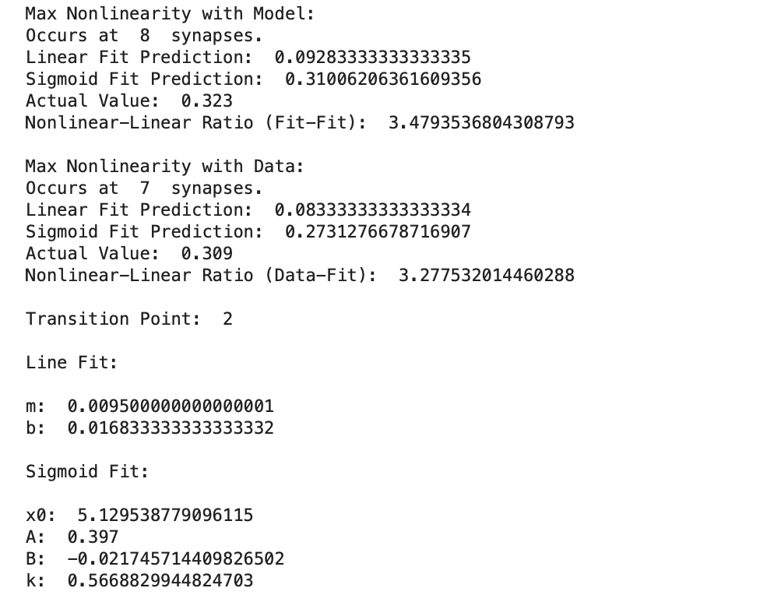
CASE #5:
Frequency: 100 Hz
GABA Firing Distribution: 1.5 ms
Current Amplitude: 3.33 nA

Slide 13
CASE ANALYSIS

